Slide 1


Lecture 9:
Pokemon Classifier
Application (Backend)
McGill Artificial
Intelligence Society

Slide 2
Goal For The Next 2 Days
Building a full webapp for a pokemon classifier using the knowledge we have learned in the course so far.
ADD SCREENSHOT OF WEBAPP

Slide 3
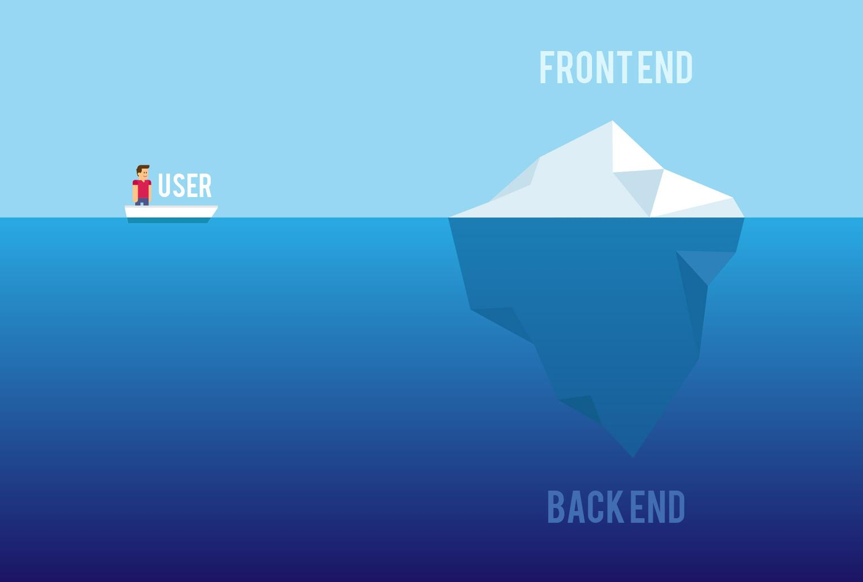
Web Application Structure
A web application contains two high level components called the backend and frontend which are usually built separately.

Slide 4
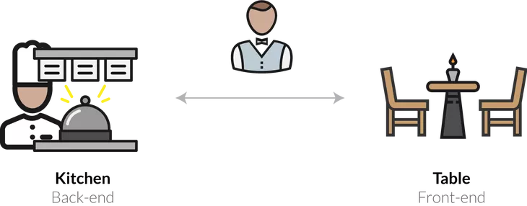
Web Application Structure
The better understand this, let’s use a restaurant as an example.
In a restaurant, the kitchen would be the backend while the table would be the frontend. We often called the backend the server-side while the frontend is called the client-side.

Slide 5
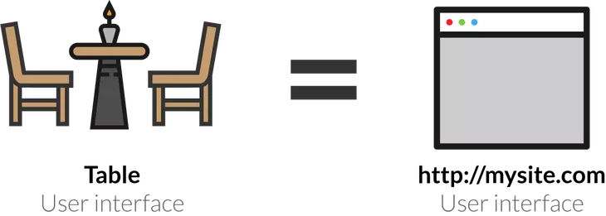
Web Application Structure
The front-end of webapp consists of a user interface which is a structured way for users to interact with the code.
In a restaurant, this would be the table which is a controlled way for customers to interact with staff in order to get what they want.

Slide 6
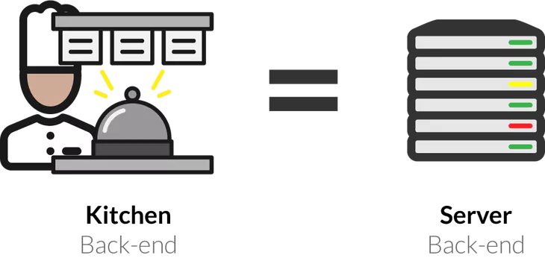
Web Application Structure
The backend consists of a server which handles all the logic in the application to provide the user with with what they need without revealing any of the underlying algorithms.
In a restaurant, this would be the kitchen which handles the process of making the food for the customer without revealing any of the recipes.

Slide 7
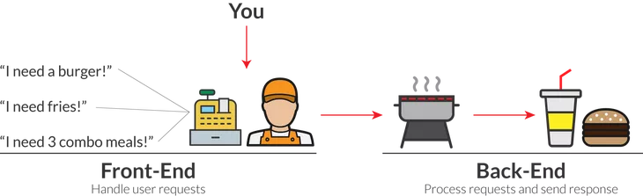
Web Application Structure
Essentially the goal of the front-end is to provide the users with everything they need without the users having to worry about any of the logic that is happening in the back-end.

Slide 8
Today’s Focus
Today we will focus on how to build the server - the part of our application that contains all the logic used in our application including the trained model itself.
In the end, the front-end should be able to give the server a picture of a pokemon and the server should be able to return the correct classification.
The front-end will not care how you decided the classification, it just wants it to be correct.
The server essentially will abstract away all the other complexities that is our data processing and our neural network.

Slide 9



Slide 10
What Is Flask?
Micro web framework written in Python
Web frameworks aim to support development of web applications by limiting overhead for building common functionality such as web APIs
Pinterest and Linkedin uses Flask in some of their applications
Popular alternative web framework for machine learning is Django

Slide 11

Why Flask ?
1 Python
Machine learning models are usually written and trained in Python. Being able to stick with the same language is always ideal.
2 Simplicity
Flask aims to offer the most minimalistic framework that still functions well in order to help you get started fast.
3 Flexible
It’s simplicity also results in lots of flexible for you to structure your application to meet custom needs.
4 Open Source
It is actively being maintained and developed by the open source community.
5 Documentation
The open source also results in very good public documentation with lots of online resources to help.
Note: All these can also be a
disadvantage in many scenarios

Slide 12
In fact… Flask is so simple that we just get started with coding right away!

Slide 13

Hello World Application
When we send a request to the root url on the flask server, we should get a hello world response.
REQUEST - “/”
RESPONSE - “Hello World”

Slide 14
Application Programming Interfaces (APIs)
Everytime we communicate with the server, we have to send a request and then we get a response.
A server will have a collection of endpoints (url’s) that we can send the requests to.
These endpoints are the APIs (Application Programming Interface) to our web application
The only way the user can interact with the server is through the APIs that are created for the application.

Slide 15
REST APIs
REST APIs are a universal standard for APIs which categorizes our endpoints into different types:
GET - Retrieve a specific resource or a collection of resources.
POST - Sends data to be accepted and processed by the server.
PUT - Updates an existing resource.
CREATE - Creates a new resource.
DELETE - Removes an existing resource.

Slide 16

https://www.getpostman.com/

Slide 17

https://www.chatroom-server.com/
Chatroom Activity!

Slide 18
Back To Our Pokemon Classifier
Now we know how REST APIs and servers work, let’s create our pokemon classifier.
REQUEST - Send a picture of a pokemon to the server.
RESPONSE - The predicted classification.
What kind of request is this? GET, POST, PUT, CREATE, DELETE?
Let’s create the endpoint first!

Slide 19
Classifier Endpoint
The structure of our endpoint will be as follows:
app.py
Server
REQUEST (POST)
url -> “/classify”
body -> .png file
RESPONSE
json -> prediction

Slide 20
Object Oriented Approach
An object oriented approach helps to keep source code modular,
maintainable, and scalable for the future.
Also hides all the most likely messy machine learning training code that we will not be needing for prediction.
predictor.py
app.py
REQUEST (POST)
url -> “/classify”
body -> .png file
Predictor
Server
RESPONSE
json -> prediction

Slide 21



Train and Save Model
.joblib
.ckpt
.pth

Slide 22
Model Architecture
ADD FINAL ARCHITECTURE FOR CLASSIFIER MODEL

Slide 23
Integrate Model Into Server
Encapsulate model into an object to follow OOP approach.
Modify predictor method to use our newly trained model.
We now have a fully working server!
model.pth
predictor.py
app.py
ML Model
Predictor
Server

Slide 24
Thanks!
Any questions?
McGill Artificial
Intelligence Society

